Slide 1
Lecture-4 aquifer influx models
Pot aquifer
Schilthuis’ steady-state
Hurst’s modified steady-state
The van Everdingen-Hurst unsteady-state
Edge-water drive
Bottom-water drive
Linear-water drive
The Carter-Tracy unsteady-state
Fetkovich’s method
Radial aquifer
Linear aquifer

Slide 2
Do you know Farouk Al Kasim?

Slide 3
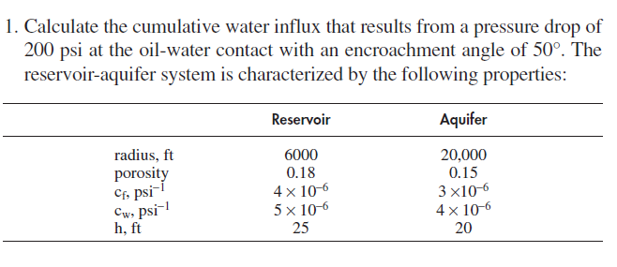
Problem-1 Tarek Ahmed

Slide 4
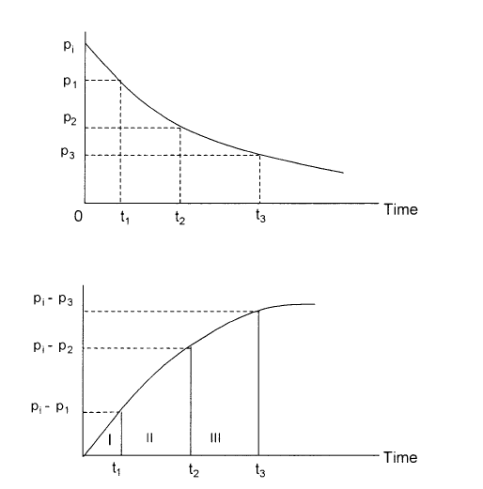
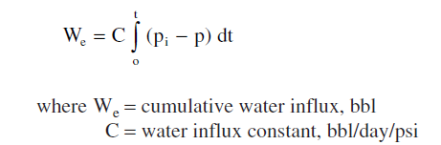
Water influx constant
or

Slide 5
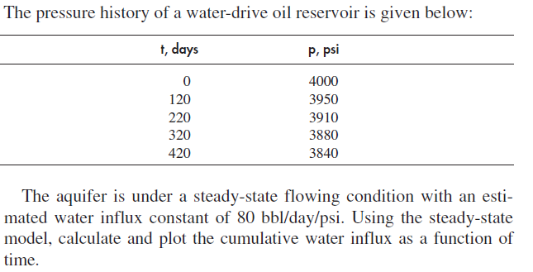
Problem-3 Schilthuis

Slide 6
Water influx models
Hurst’s modified steady-state model.
The problem with the Schilthuis’ steady-state model is that the water is drained from the aquifer, the aquifer drainage radius ra will increase as the time increases. Hurst (1948) proposed that the aquifer radius ra will be a function of time.
Dimensionless radius
Schilthuis’ model will be

Slide 7
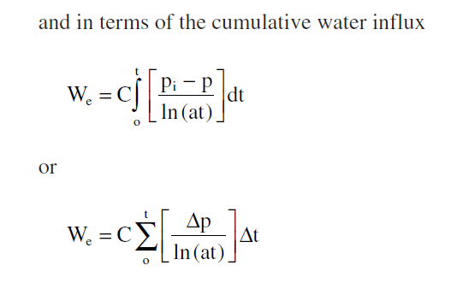
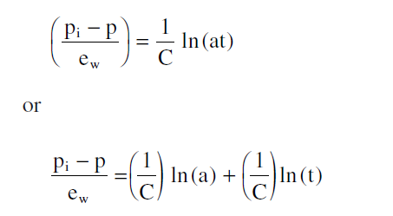

Slide 8
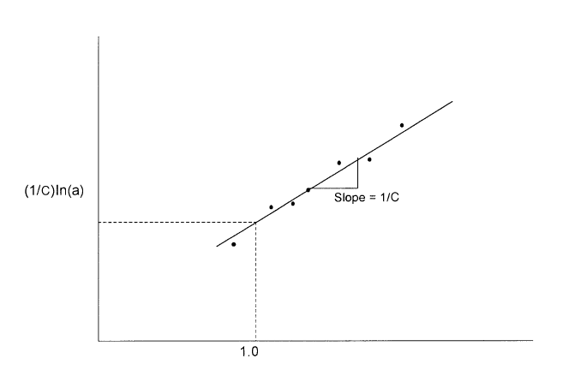
Determination of the two unknown constants a and C.

Slide 9
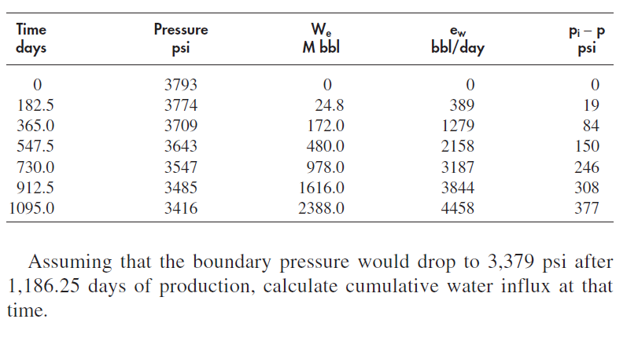
Example 10-5 Hurst

Slide 10
Solution

Slide 11
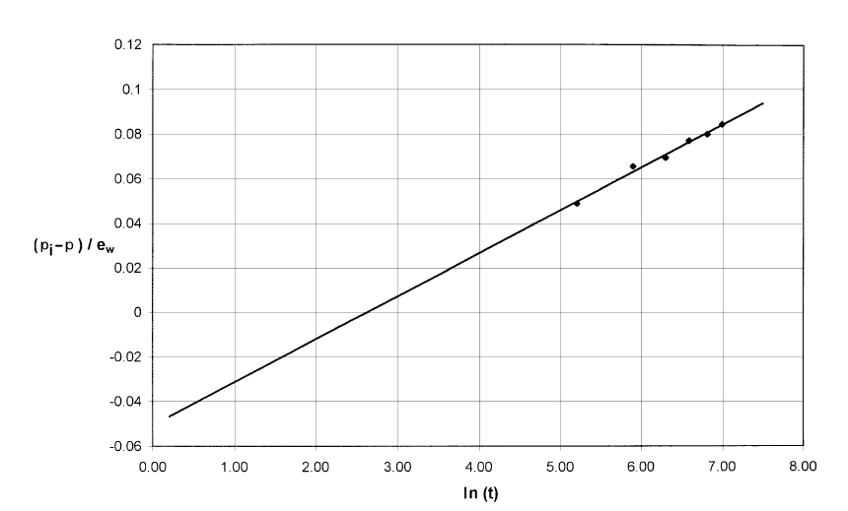
Solution

Slide 12
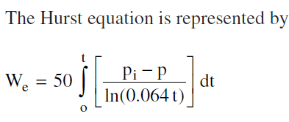
Solution
Using any point at the straight line to find the constant a

Slide 13
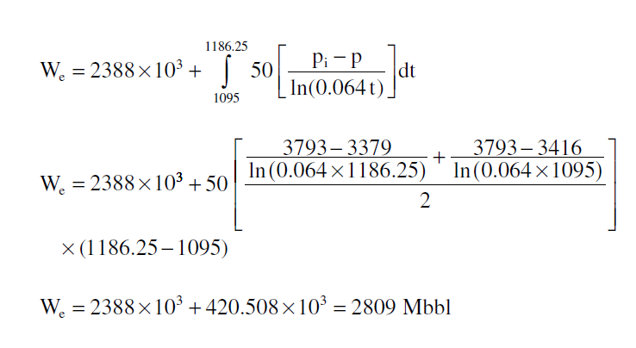
Solution

Slide 14
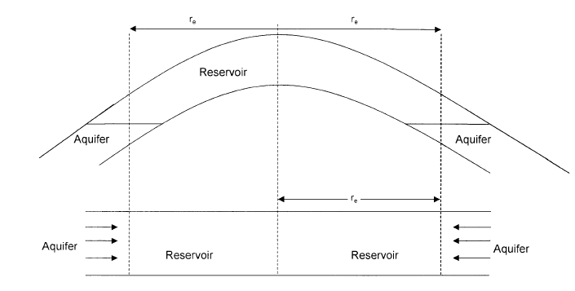
The van Everdingen-Hurst unsteady-state
Dimensionless diffusivity equation
Van Everdingen-Hurst
They solved diffusivity equation for
Water influx by applying the laplace transformation

Slide 15
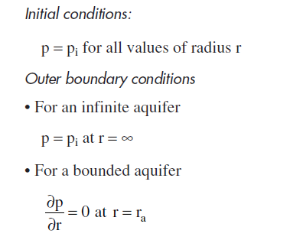
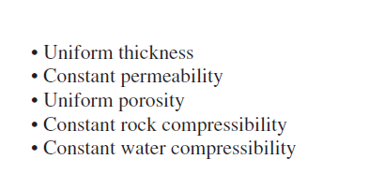
The constant terminal presssure at the initial and outer boundary condtions
The Van Hurst assumed that the aquifer is characterized by:

Slide 16
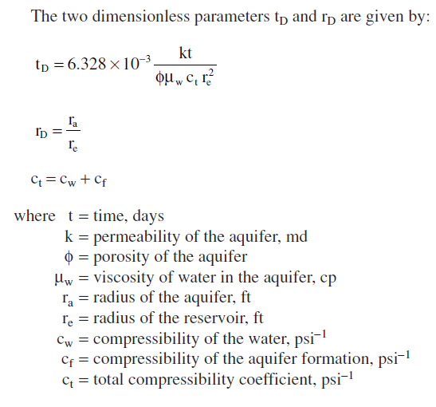

Slide 17
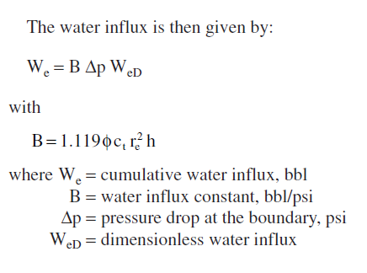
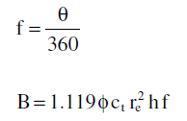
Water does not encroach on all sides of the reservoir, or the reservoir is not circular in nature.

Slide 18
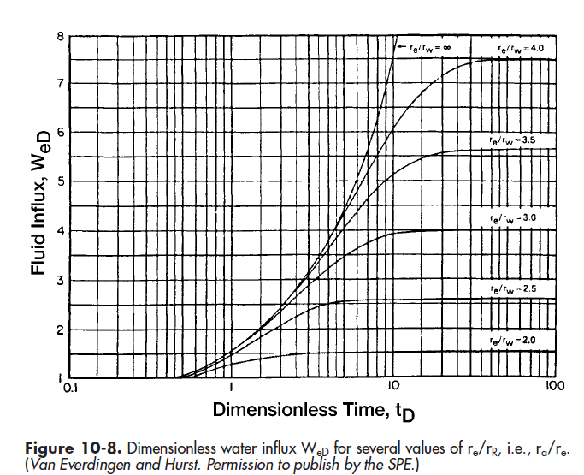
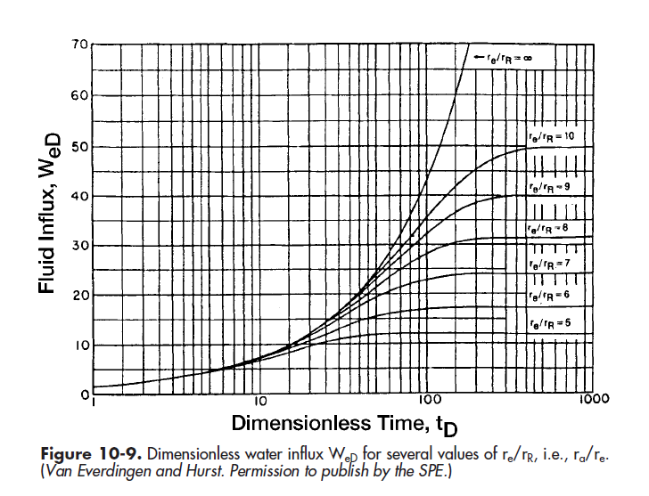
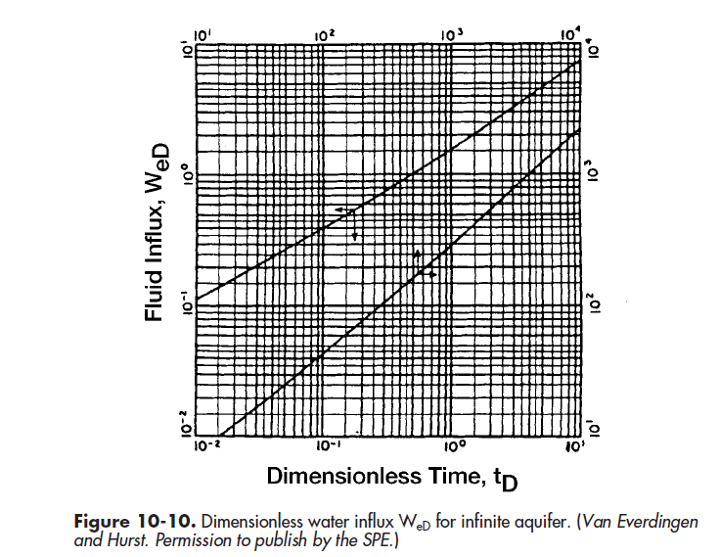
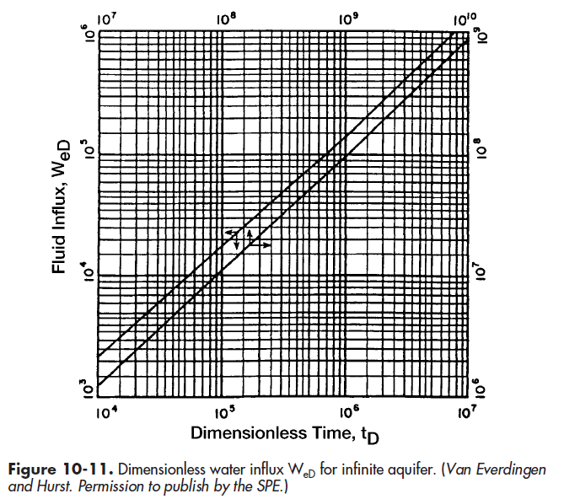

Slide 20
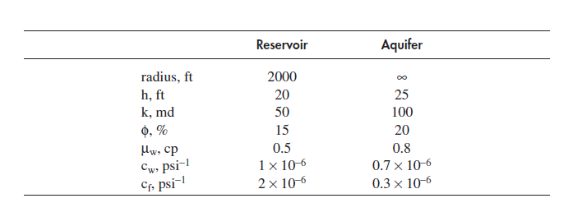
Example 10-6 Van Everdingen and Hurst

Slide 21
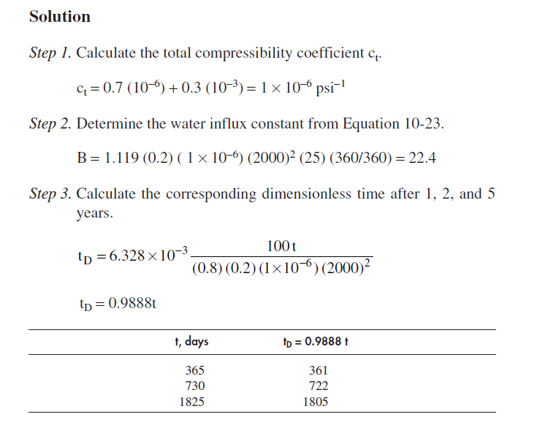

Slide 22
Use table 10-1 (Tarek Ahmed), take the average of WeD between two points of tD if the given tD is in between.
Then calculate the cumulative water influx by:
What is wrong here ?

Slide 23
See you next time inshallah
HAVE A NICE TIME

